Slide 1

FLIGHT TICKET RESERVATION SYSTEM

Slide 2

Flight ticket reservation system
Flight ticket reservation system is a software application designed for booking Flight ticket for passengers
Flight ticket reservation is a process of booking a seat on an airplane for a specific date and time to travel from one location to another

Slide 3

Uses
This process is essential for ensuring a smooth and organized travel experience
Payment gateway integrated
Currency
Mobile friendly design
Time
Convenience

Slide 4
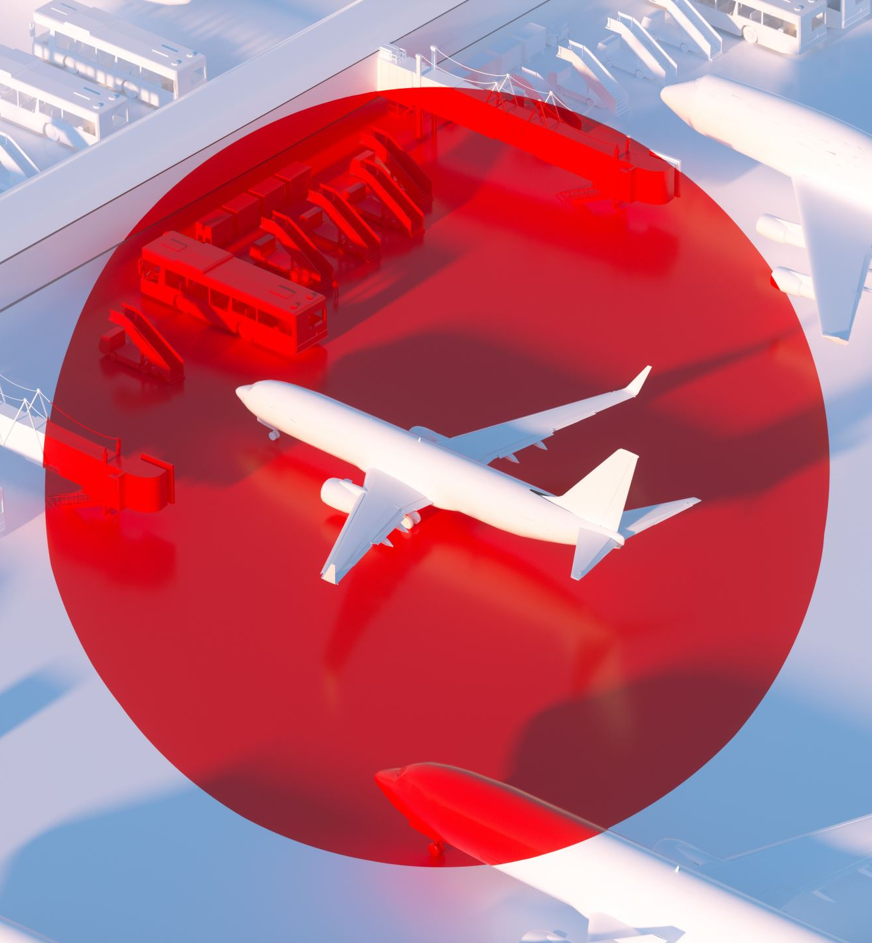
PROJECT OVERVIEW
It allows passengers to browse the available flights,book tickets and also for cancel reservation of needed
Reduces the physical work burden

Slide 5

ARCHITECTURE
High level architecture diagram
System consists of 3 main components
Java application
Myself database
JDBC driver

Slide 6

Explanation of components
Java application
My sql database

Slide 7

JDBC driver
Communication flow

Slide 8

TABLES AND FIELDS
Flight Table Records the details of Flight id, flight name, source, destination and available seats
Ticket Table Records the details of Passenger Name, Phone number, date, source, destination and ticket

Slide 9
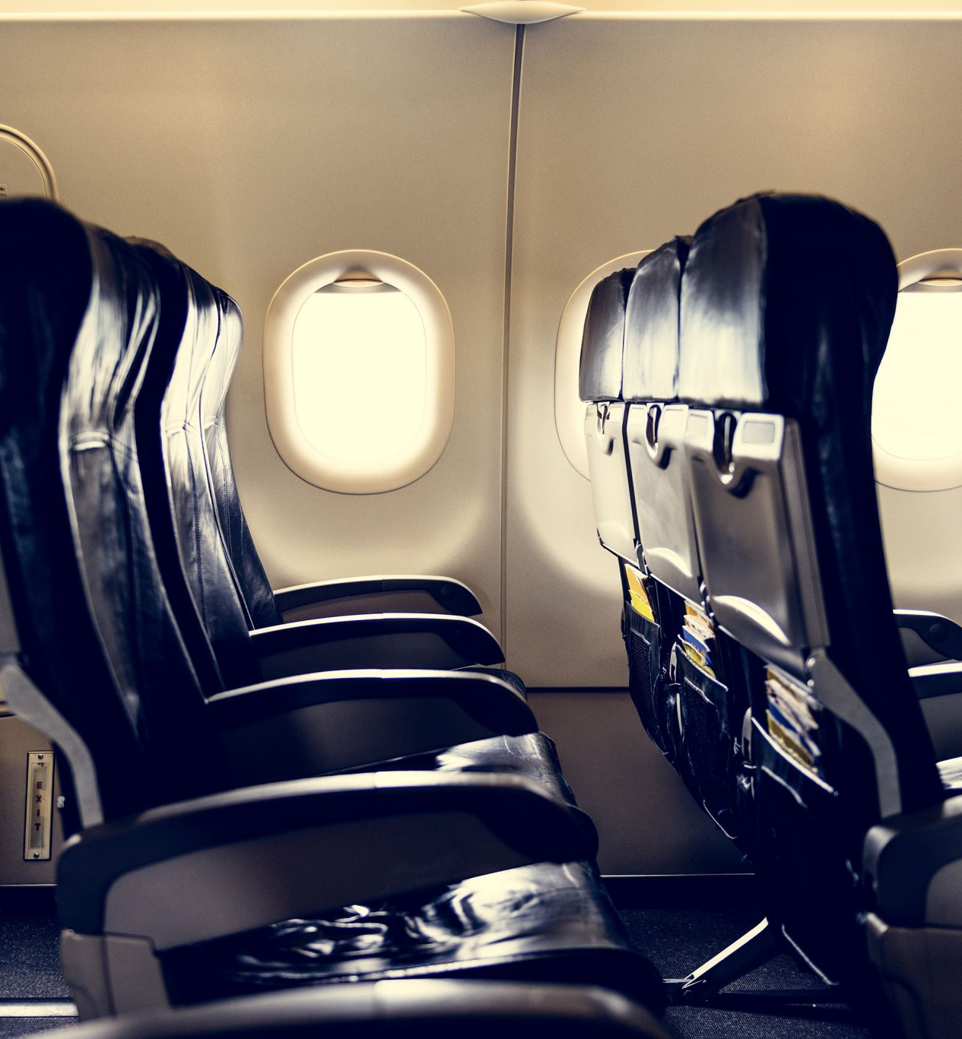
Relationship between tables
Relationship between Table the Flight ID field in the ticket table serves as a foreign key referencing the ID field in that Flight Table uses One to Many Relationship Model

